Slide 1
Triple Modular Redundancy
Where Trust Issues Meet Engineering
Zach Martin
ECE 526
Fall 2024

Slide 2

Key Terms
Single Event Upset (SEU)
A change of state caused by a single ionizing particle striking a sensitive node in a live electronic device.
Fault Tolerance
The ability of a system to maintain proper operation despite failures or faults in one or more of its components.
Triplex Systems
A system provided or fitted in triplicate so as to ensure reliability.
Triple Modular Redundancy
Three systems performing the same process, with the results processed by a majority-voting system to produce a single output.

Slide 3
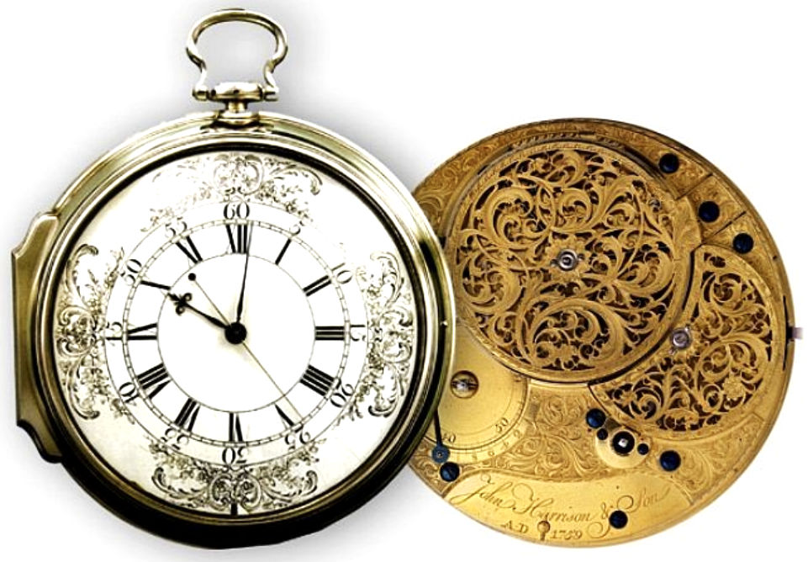
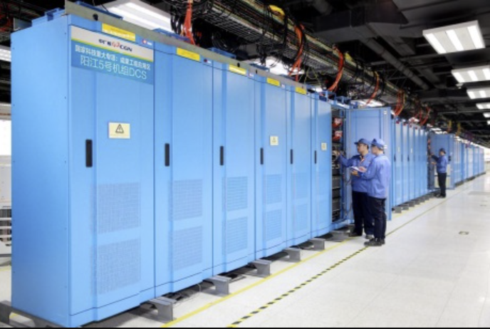
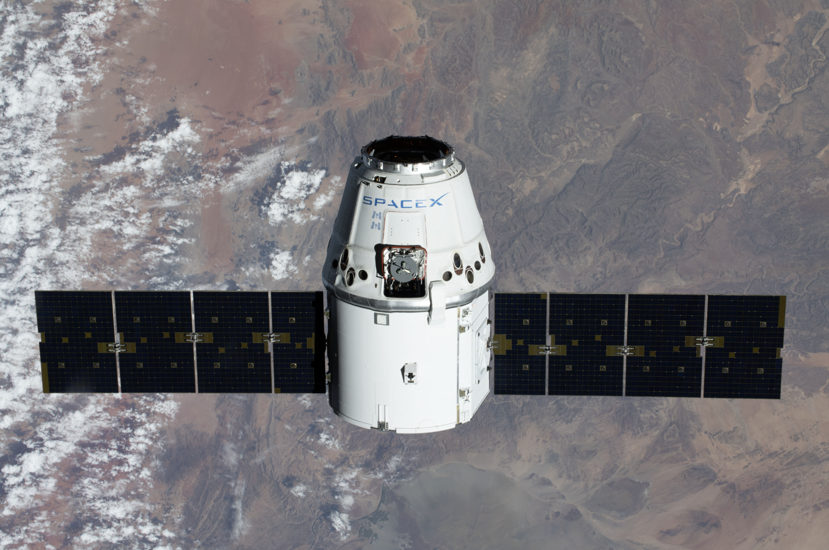
Uses
Ocean Travel
Marine Chronometers
Nuclear Power Facilities
Critical Instrumentation and Control (I&C) Systems
Space Exploration
Saturn Launch Vehicle Digital Computer (LVDC)
SpaceX Dragon Cargo Vessel
John Harrison’s H4 Marine Chronometer
China General Nuclear I&C System
Dragon 1 Vessel Delivering Payload to the ISS

Slide 4
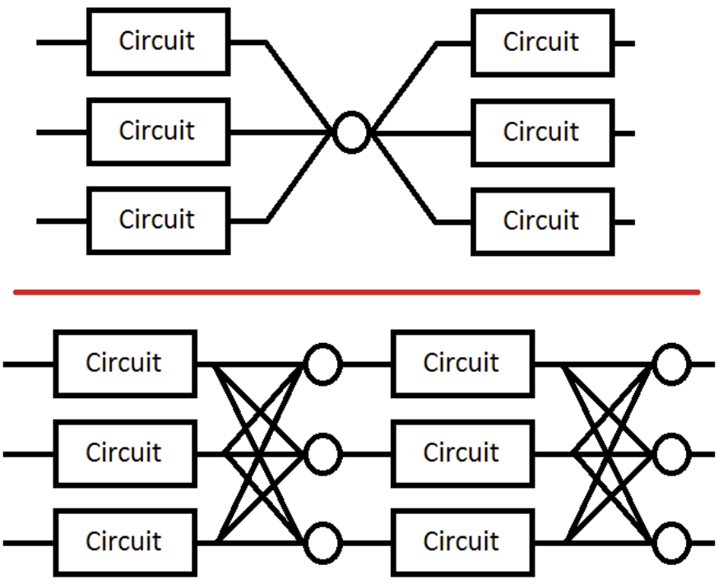
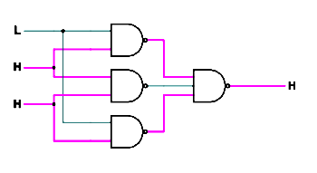
Design
Three-Module NAND Majority Gate (Voter)
One-Voter System (Top) vs. Three-Voter System (Bottom)

Slide 5
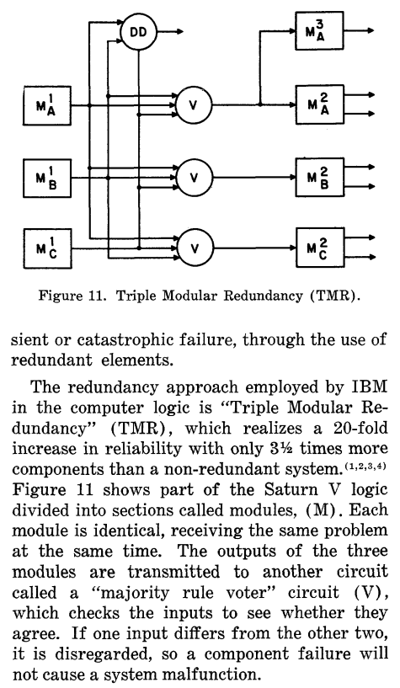
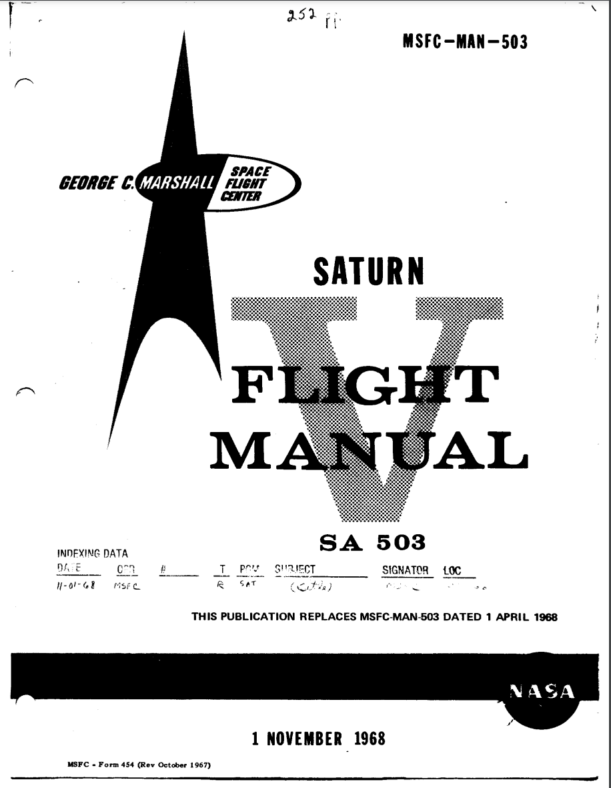
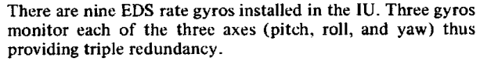
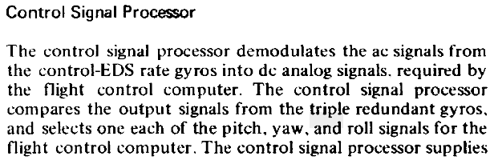
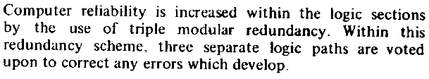
Saturn LVDC
Excerpt from IBM Paper on TMR Design Used in LVDC
Saturn V Flight Manual Cover Page November 1, 1968
Flight Manual Entries on TMR (pp. 157, 159, 163)

Slide 6
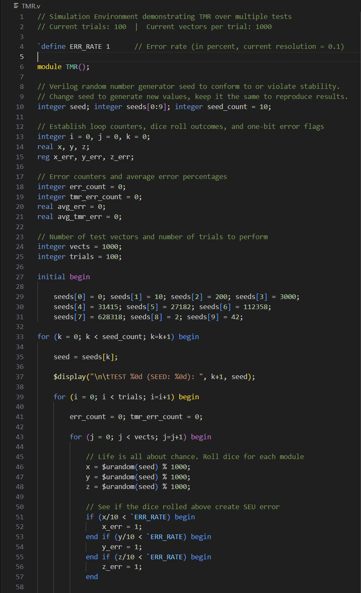
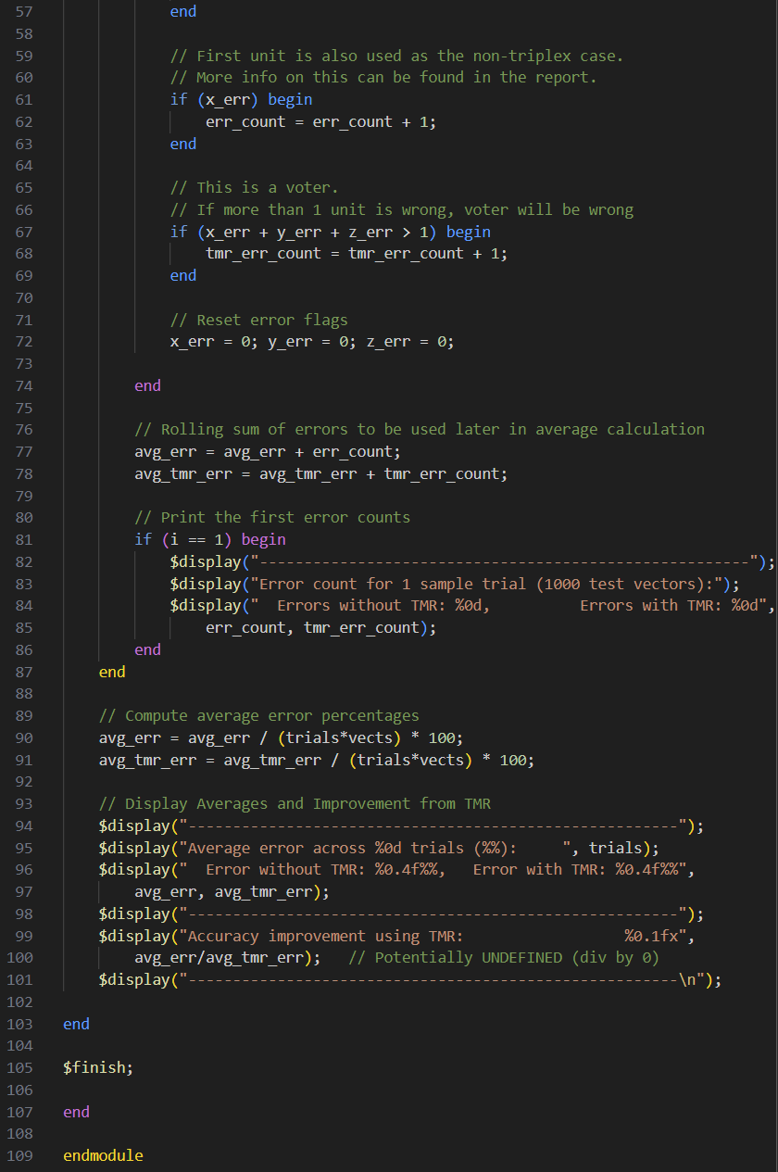

Slide 7
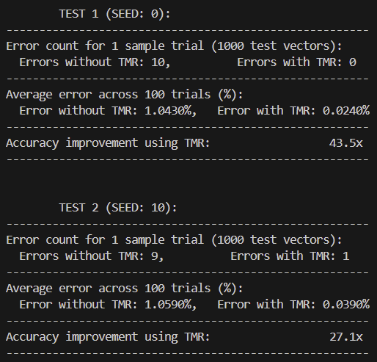
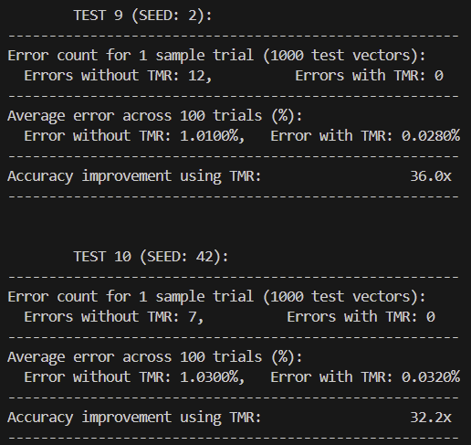
Verilog Module Command Line Output

Slide 8
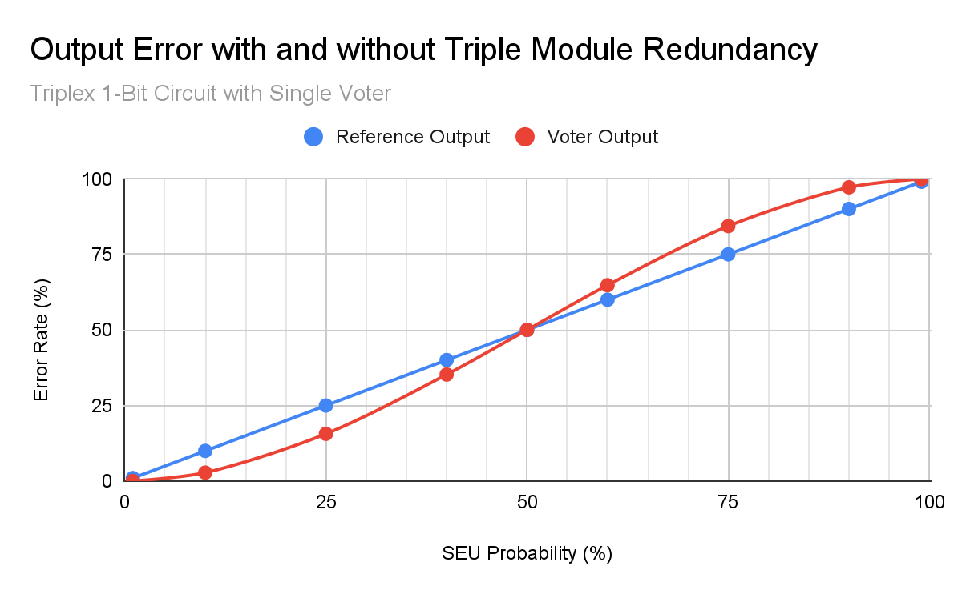
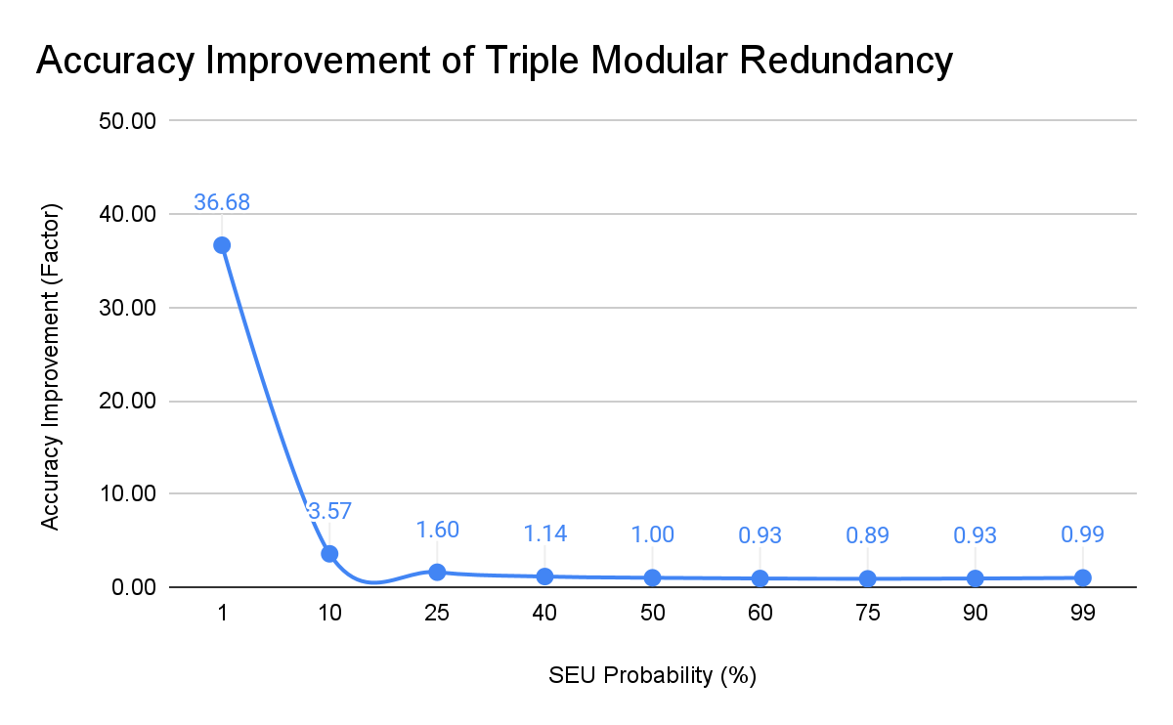
Test Results

Slide 9
Limitations
Redundancy is sometimes unnecessary, and is always expensive
Financial cost: Sensitive systems are often high-grade and made of expensive parts
Spatial cost: Tripling a system triples its physical footprint
Power cost: Three times the circuitry requires at least three times the power consumption
TMR reduces accuracy in a high-fault environment
Other, more fault-tolerant systems exist, such as Hamming Error Correction Code (ECC)
While they are not as fast, they can resist faults more “evenly”

Slide 10
Citations
NASA. Saturn V Flight Manual SA-503. 1 Nov. 1968. NASA Technical Reports Server, https://ntrs.nasa.gov/citations/19750063889.
Dickinson, M. M., J. B. Jackson, and G. C. Randa. "Saturn V Launch Vehicle Digital Computer and Data Adapter." Proceedings of the Fall Joint Computer Conference, 1964, ACM, 1964, pp. 501–516. https://dl.acm.org/doi/10.1145/1464052.1464099.
Shirriff, Ken. "A Circuit Board from the Saturn V Rocket, Reverse-Engineered and Explained." Ken Shirriff's Blog, 2 Apr. 2020, https://www.righto.com/2020/04/a-circuit-board-from-saturn-v-rocket.html.
"Chinese I&C System Passes IAEA Review." World Nuclear News, 15 July 2016, https://www.world-nuclear-news.org/Articles/Chinese-I-C-system-passes-IAEA-review.
"The First Marine Chronometer." Times Ticking, https://www.timesticking.com/the-first-marine-chronometer/.
"Dragon's 'Radiation-Tolerant' Design." Aviation Week Network, 20 Nov. 2012, https://aviationweek.com/dragons-radiation-tolerant-design.

